Slide 1

Wilson Financial Case Study
Group Charlie

Slide 2
Team Members
Greih Murray
Yolanda Brown
Fatih Suljovic
Boussofyane Ilboudo

Slide 3
Wilson Financial
A family owned finance office in New Mexico
Owned by two brothers, both educated in finance and investment
Two additional employees
Looking for ways to expand while still ensuring quality

Slide 4
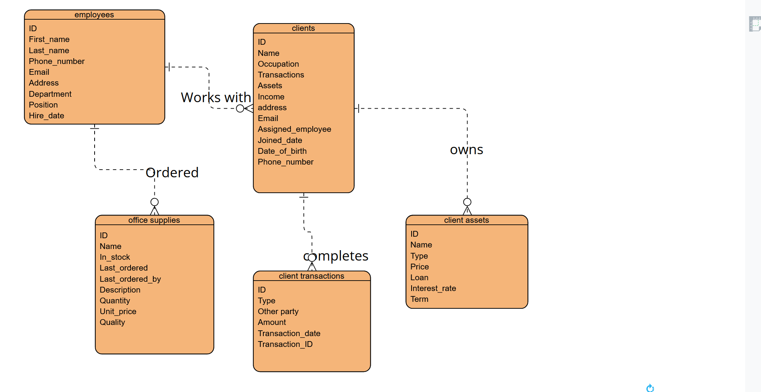
ERD/Data Model

Slide 5
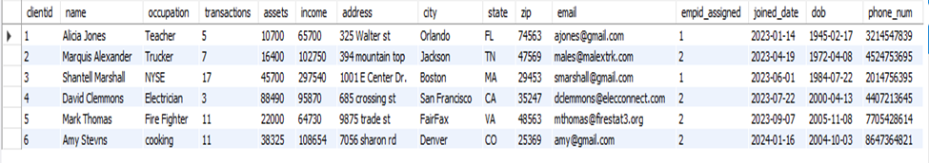
Client Table

Slide 6
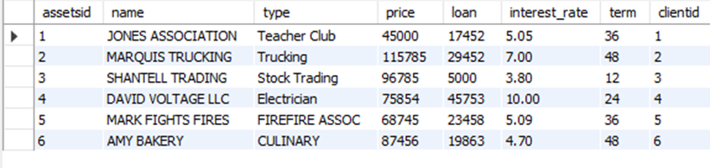
Client Asset Table

Slide 7
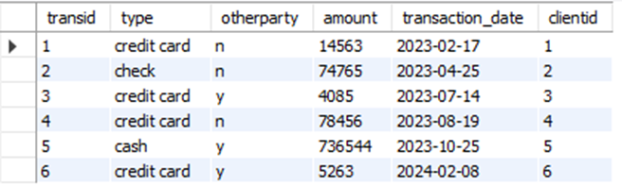
Client Transaction Table

Slide 8
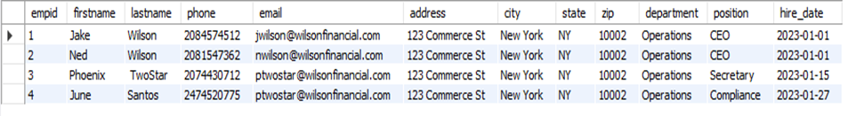
Employees Table

Slide 9
Reports

Slide 10
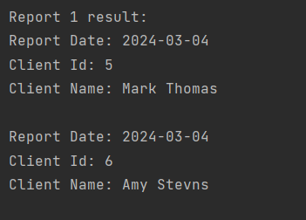
New Client Report
Clients that have joined the firm in the past six months
Used to track overall client base growth and trends
SQL Query:
SELECT CURDATE() AS report_date, clientid, name FROM clients WHERE joined_date >= DATE_SUB(now(), INTERVAL 6 MONTH);

Slide 11
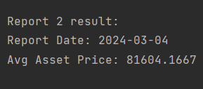
Average Asset Report
Used to see the average value of client assets
Can also be used to track the change of average asset value over time
SQL Query:
SELECT CURDATE() AS run_date, AVG(price) AS avg_price FROM clientassets;

Slide 12
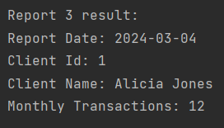
High Transaction Report
Report to track which clients have a high (over 10) number of monthly transactions
Can show which clients will have the most involved work
SQL Query:
SELECT CURDATE() AS report_date, tr.clientid, cl.name, COUNT(*) AS monthly_transactions FROM clienttransactions AS tr JOIN clients AS cl ON cl.clientid = tr.clientid WHERE transaction_date >= DATE_SUB(now(), INTERVAL 1 MONTH) GROUP BY clientid HAVING COUNT(*) > 10;

Slide 13
Assumptions
High transaction report only runs for the previous month
Each client will primarily work with a single employee
Each transaction and asset can only be affiliated with one client but each client can be affiliated with multiple transactions and assets
Tracking SEC regulations in a local database would be a wasted effort

